Slide 1
Breast Cancer Diagnosis Predictor
End-to-end ML project deployed with Flask
Week 4 Task: AI Project Deployment & Capstone | [Your Name]
Notes:
Introduce the project: a complete ML application from data to deployed API.

Slide 2
Objectives & Problem
1
Build end-to-end ML project
Preprocessing, training, testing, deployment
2
Serialize the model
Pickle / Joblib, simple prediction API
3
Deliver a complete application
Documentation, tests, presentation
Task: predict whether a tumour is malignant or benign from 30 cell-nucleus measurements.

Slide 3
Dataset: Wisconsin Diagnostic Breast Cancer
569
30
0
63%
patient samples
numeric features
missing values
benign (357 / 212)
10 nucleus properties: radius, texture, perimeter, area, smoothness, compactness, concavity, concave points, symmetry, fractal dimension
Each summarised as mean, standard error and worst value = 30 features
80/20 stratified train-test split (455 / 114), random_state = 42

Slide 4
End-to-End Pipeline
1. Load & inspect
2. Stratified split
3. Scale + model (Pipeline)
4. CV + GridSearch
5. Evaluate on test set
6. Joblib / Pickle
7. Flask API + UI
Scaler lives inside the Pipeline, so no data leakage and identical preprocessing at prediction time.

Slide 5
Model Selection (5-fold CV)
Winner: Logistic Regression
Best and most stable CV score
Fast, tiny, interpretable
GridSearchCV tuned C = 0.1

Slide 6
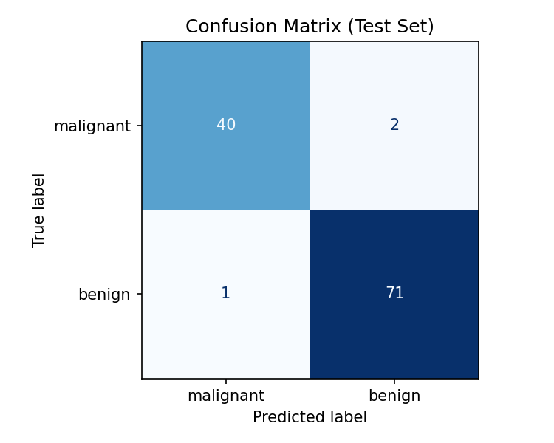
Results on Unseen Test Data
97.4%
Accuracy
98.6%
Recall
97.9%
F1-score
0.996
ROC-AUC
Only 3 of 114 test samples misclassified

Slide 7
Model Serialization
import joblib, pickle
# save the full pipeline
joblib.dump(model, "models/model.joblib")
pickle.dump(model, open("models/model.pkl","wb"))
# load inside the API
model = joblib.load("models/model.joblib")
Joblib: loaded by the API
Pickle: standard-library alternative
metadata.json: feature names, ranges, metrics
Only load model files from trusted sources, and with the same scikit-learn version.

Slide 8
Flask Prediction API
Method | Route | Purpose
GET | / | Web interface
GET | /health | Health check
GET | /features | Feature names & ranges
POST | /predict | JSON in, prediction + confidence out
POST /predict -> {"prediction": "malignant", "confidence": 1.0,
"probabilities": {"benign": 0.0, "malignant": 1.0}}
Bad input -> HTTP 400 {"error": "Missing features: [...]"}

Slide 9
Testing & Deployment
Testing
7 automated API tests, all passing
Valid, malformed and missing inputs covered
Live server verified with curl
Deployment
gunicorn production server
Dockerfile: build, train, serve
Ready for Render / Railway / AWS
Run: python train.py, then python app.py

Slide 10
Conclusion
Complete ML lifecycle delivered, from raw data to a live API
97.4% test accuracy, 0.996 ROC-AUC with a simple, explainable model
Serialized with Joblib and Pickle, served through Flask with validation
Future work: threshold tuning for malignant recall, SHAP explanations, CI/CD, FastAPI
Educational demo only; not a medical device
Thank you | Questions?

